Slide 1
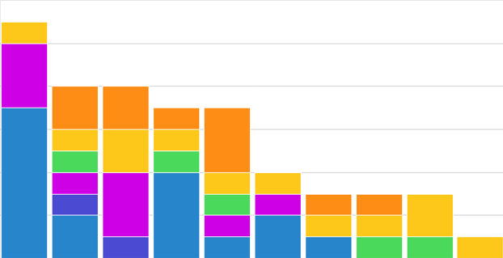
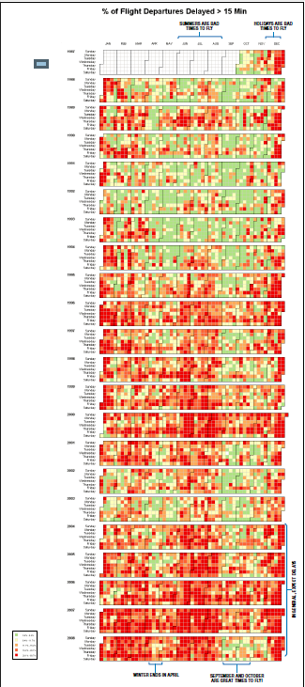
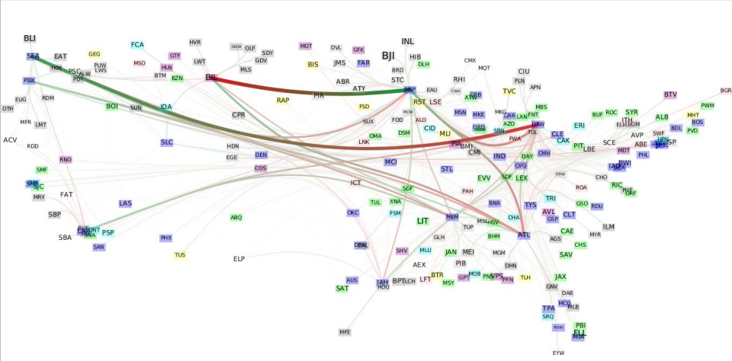
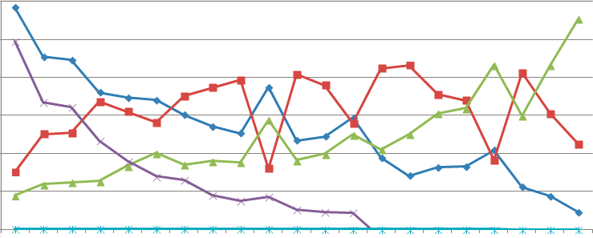
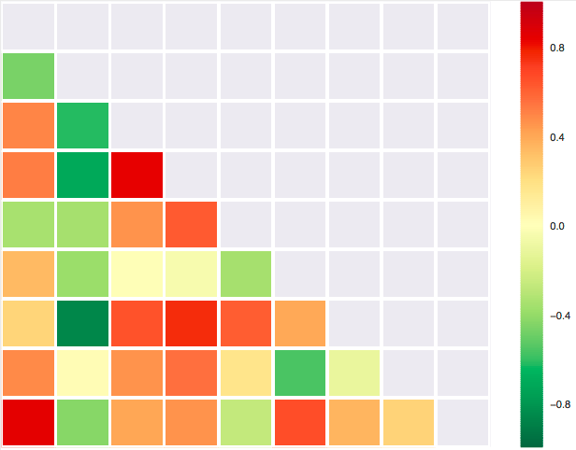
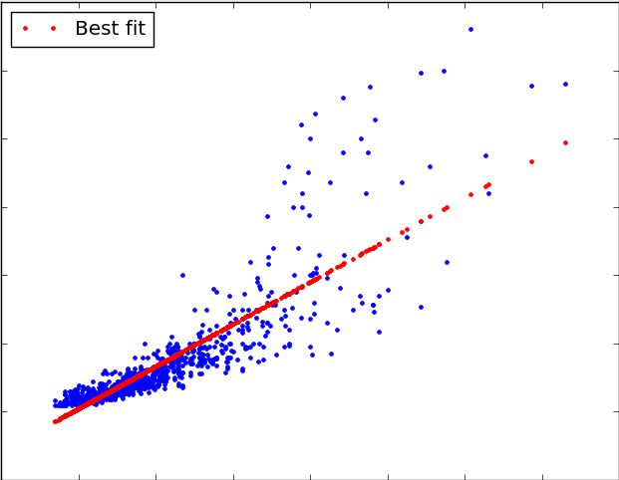

The Data
From 1999 to 2008, ten years of data on commercial domestic flights forairports in the United States .
Goals
【Temporal exploration】
• What is the best time for travelling?
• Time-lapse series of graph showing performance of airports (year to year)
• The airline/airport delay and performance influenced by perticulare global events. e.g:1999 - 2000 & 2001
【Spatial exploration】
• Find the worse/best performing airports and airlines?
Data Information and Project Goals
Tools
Group Members
PROJECT LEARNED:
•
•
•
•
•
•
•

Slide 2
The Data
From 1999 to 2008, ten years of data on commercial domestic flights forairports in the United States .
Goals
【Temporal exploration】
• What is the best time for travelling?
• Time-lapse series of graph showing performance of airports (year to year)
• The airline/airport delay and performance influenced by perticulare global events. e.g:1999 - 2000 & 2001
【Spatial exploration】
• Find the worse/best performing airports and airlines?
Data Information and Project Goals
The first main visulization shows the networks of each airports and airlines. Nodes identified in different colors by using k-core, and edges(airlines) in different weights affected by centrality.
Simple Bar Charts and Line Charts
D3 Calendar show from 1999 to 2008 flights delay.
Tips and Summary
PROJECT LEARNED:
•
•
•
•
•
•
•
Correlation Matrix shows the correlation between delay reasons.
Statistic Analysisi by using R
Project Learned
Bubble Charts for airlines comparison analysis

Slide 3
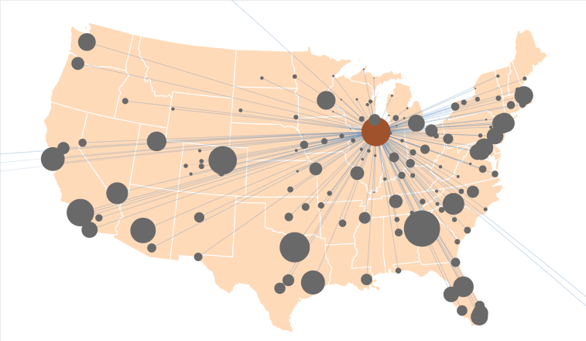
The Data
From 1999 to 2008, ten years of data on commercial domestic flights forairports in the United States .
Goals
【Temporal exploration】
• What is the best time for travelling?
• Time-lapse series of graph showing performance of airports (year to year)
• The airline/airport delay and performance influenced by perticulare global events. e.g:1999 - 2000 & 2001
【Spatial exploration】
• Find the worse/best performing airports and airlines?
Data Information and Project Goals
The second main visulization is an interactive one, which shows the networks of each airports and airlines. Nodes sizes influenced by persentage of delays.
Simple Bar Charts and Line Charts
D3 Calendar show from 1999 to 2008 flights delay.
Tips and Summary
PROJECT LEARNED:
•
•
•
•
•
•
•
Correlation Matrix shows the correlation between delay reasons.
Statistic Analysisi by using R
Project Learned
Bubble Charts for airlines comparison analysis

